Slide 1
City of Portland Employee Presentation
May 2024

Slide 2
Understanding your health care plan is important
2 | Meritain Health
Meritain Health Confidential

Slide 3
So, let’s talk about:
What you should know about your health care.
Choosing the best options for you and your family.
How to enroll and start using your benefits.
3 | Meritain Health
Meritain Health Confidential

Slide 4
Let’s get started
Eligibility
Preventive care
Precertification
Medical benefits
Online resources
Provider network
Enrollment
Contact us
4 | Meritain Health
Meritain Health Confidential
Notes:
Each bullet point links to the corresponding slide. Each slide has a HOME icon that links back to this slide. You can delete slides as needed without interrupting these links.
Note: You may need to relink the “Healthcare spending accounts” to the appropriate slide (HRA, HSA, FSA).
To relink icons:
Right click the corresponding icon
Click “Edit Hyperlink”
Choose “Place in This Document”
Highlight the appropriate slide number
Click “Ok”

Slide 5
No surprises,
just
information.

Slide 6
Section
1
Who’s eligible

Slide 7
Who’s eligible
Your eligible dependents may include:
Your spouse or domestic partner.
Your children, natural or adopted.
Your stepchildren.
Dependent coverage is available for any child (regardless of marital status, residency, student status, etc.) of an employee who is deemed to be the employee’s biological, step, foster or adopted child (including a child placed for adoption) until such child reaches age 26.
7 | Meritain Health
Meritain Health Confidential
Notes:
Action: Deleted red text that does not apply. Make all red text black before use. Children include:
Children who have been placed with you for adoption.
Children for whom you are the legal guardian. ACA: Dependent coverage is available for any child (regardless of marital status, residency, student status, etc.) of an employee who is deemed to be the employee’s biological, step, foster or adopted child (including a child placed for adoption) until such child reaches age 26.
Discuss spousal coverage rules if the group does not cover spouses that have their own coverage or may have higher premium if spouse has option for coverage at their own employer.
Delete domestic partner if group does not cover.

Slide 8
Choosing who to cover
Family members covered by a different plan?
When you have benefits from two plans
Enroll yourself and eligible dependents
Enroll yourself, but decline benefits for some—or all—eligible dependents
Both plans will coordinate benefits
One plan will be considered primary—or first payer
The secondary plan pays only after the first plan has paid
We use a birthday rule to decide which plan is primary

Slide 9
Open enrollment and qualifying events
If you enroll or decline coverage now, you may be able to add, delete or change your benefit choices:
During your employer’s next open enrollment period.
If you have a qualifying event, such as:
Involuntary loss of benefits.
Marriage.
Birth.
Adoption.
Placement of a child in your home for adoption.
Meritain Health Confidential
Notes:
Birthday rule: One plan is considered primary and the other secondary based on which parent’s birthday comes first during the year.
Qualifying events include involuntary loss of benefits, marriage, birth, adoption, placement of a child in your home for adoption

Slide 10
Section
2
Choose a plan that fits you

Slide 11
Preventive care
When combined with healthy eating and exercise, vaccines and early detection are your keys to a long and healthy life.
Preventive care for adults and children
Routine screenings and check-ups
Counseling to prevent illness, disease or other health problems
Your plan covers
100% at Tier 1 and Tier 2
Meritain Health Confidential
Notes:
Women’s preventive services and prescriptions include:
Prenatal care
Generic contraceptives
Lactation counseling
Breast pumps
Insertion of IUDs or injections
Sterilization procedures

Slide 12
Medical benefits at-a-glance
 | Tier 1 | Tier 2 | Tier 3
 | Deductible
Individual | $400 | $1,000 | $1,000
Family | $800 | $2,000 | $2,000
 | Plan payment
 | 90% | 90% | 80%
 | Out-of-pocket max
Individual | $1,500 | $2,500 | $2,500
Family | $3,000 | $5,000 | $5,000

Slide 13
Medical benefits at-a-glance
 | Tier 1 | Tier 2 | Tier 3
Routine check-up | $0 | $0 | 70% after deductible
Primary care office visit | $0; deductible waived | 70% after deductible | 70% after deductible
Specialist office visit | $20; then 100% deductible waived | Paid at the Tier 1 level of benefits | 70% after deductible
Hospital expenses | 90% after deductible | Paid at the Tier 1 level of benefits | 70% after deductible
Diagnostic testing (XR and Lab) | 90% after deductible | Paid at the Tier 1 level of benefits | 70% after deductible
Emergency Services – Emergency Medical Condition | $100 copay; then 100% deductible waived | Paid at the Tier 1 level of benefits | Paid at the Tier 1 level of benefits
Outpatient therapies (PT, OT, Speech therapy) | $10 copay; then 100% deductible waived | Paid at the Tier 1 level of benefits | 70% after deductible
Notes:
Actions: Complete charts as needed. Duplicate slide to add additional plans, or delete “Plan B” column if group has a single plan.

Slide 14
Prescription drug benefits
Your prescription drug benefits are administered by Scrip World, powered by CVS Caremark®.
 | Retail | Mail Order
Generic | $10 | $15
Preferred | $30 | $45
Non-Preferred | $60 | $90
Specialty | $10/$30/$60 | $10/$30/$60
Notes:
Actions: Complete charts as needed. Duplicate slide to add additional plans, or delete “Plan B” column if group has a single plan.
Save on prescription costs:
Choose generic when possible—generic drugs have the lowest copay under your plan
Refer to your formulary—or preferred drug list
Save money—and time—with 90-day prescriptions by mail order, or online
Don’t forget your ID Card at the pharmacy
Not every drug is covered—check your plan for exclusions
Certain drugs must be approved—consult Scrip World for details

Slide 15
In-network providers
Get discounts and higher coverage for your health care when you use in-network doctors, clinics and hospitals.
Your network is the Aetna Choice® POS II
Find providers online: http://www.aetna.com/docfind/custom/mymeritain
Find providers by phone: 1.800.343.3140
Plus, it’s easy to find an in-network doctor—and they’ll submit claims for you.
Meritain Health Confidential
Notes:
Action: Change network name, website and phone number as needed.
Benefits of choosing in-network doctors and facilities:
Lower rates
No referrals needed
Providers submit claims
Out-of-network services may be covered at the in-network rate if:
It’s an emergency
An out-of-network provider is under agreement with an in-network provider for some of your care (e.g., anesthesiologist)

Slide 16
Precertification
Our Medical Management team will help you get the most appropriate care, when and where you need it.
Precertify before the following:
PET scans, non-orthopedic CT/MRIs
Hospital admissions
Inpatient or outpatient surgery
IV home infusion therapy or chemotherapy
Inpatient substance abuse treatment
Home health care
Skilled nursing care
Durable medical equipment (electric scooters or wheelchairs)
Call before you get care
You or your doctor can call Meritain Health Medical Management to verify which procedures need to be precertified. You can also check your Summary Plan Description (SPD) for a complete listing.
Meritain Health Confidential
Notes:
Action: Use this slide to highlight common—or problematic—precert situations. Delete or add examples as needed.
Possible entries (verify by plan):
Cataract surgery
Cholecystectomy (laparoscopic)
Colonoscopies
Durable Medical Equipment (DME) over $500 (other than breast pumps covered as a preventive service)
Ear tube placement (tympanostomy)
Heart perfusion imaging
Hospice care
Imaging, limited to the following: CT/MRA/MRI/PET scans, scintimammography, capsule endoscopy and U.S. bone density (heel)
Inpatient facility admissions (including skilled nursing, extended care, and rehabilitation)
Inpatient admissions due to a mental disorder or substance use disorder
Knee arthroscopy
Lithotripsy
Prosthetics or orthotics over $500
Removal of adenoids
Shoulder arthroscopy
Sleep studies
Tonsillectomy
Transplants
Transthoracic Echocardiogram (TTE) to include with Doppler
Upper gastrointestinal endoscopies

Slide 17
Section
4
Be healthy, live well
17 | Meritain Health

Slide 18
Access Mental Well-being Services from Anywhere
With telehealth and virtual mental well-being programs, you can easily get help you need from providers who are part of your network. So, whatever you’re facing, you’ll have support, including counseling, medication or help with mental health concerns. Plus, you can see providers when and where it’s convenient for you. However, depending on your plan coverage, some services may not be covered. You’ll want to confirm telehealth eligibility by checking your member website for plan details or calling the number on your ID card, prior to receiving services. Below is a list of providers you can access for a variety of concerns or conditions.
Depression, anxiety or mental well-being concerns
Ages | Provider | Contact | Availability
0 up to age 18 | Brightline | https://www.hellobrightline.com/meritain | Nationwide
5 and up | Telemynd | 1.866.991.2103 or https://Telemynd.com/meritain | Nationwide
13 and up | Talkspace | https://www.talkspace.com/Meritain | Nationwide
18 and up | Meru Health | https://www.meruhealth.com/sign-up/meritain/ | Nationwide
18 and up | Brightside Health | www.brightside.com/meritainhealth/ | Nationwide
18 and up | AbleTo | 1.844.330.3648 or https://member.ableto.com/meritain/ | Nationwide
Eating disorders
Ages | Provider | Contact | Availability
4 to 26 | AbleTo | 1.844.330.3648 or https://member.ableto.com/meritain/ | Nationwide
Telehealth (telemedicine) or virtual services: connects you and your provider via a secure televideo platform for counseling, support, education and medication management from the location of your choice. Availability: specific availability by state is subject to change without notice.
To learn more about your benefits or if you have any questions, simply call the number on the back of your medical ID card.

Slide 19
Teladoc Health®
24/7 medical advice by phone, website or mobile app.
U.S.-based, board-certified and state-licensed doctors that are specially trained in telemedicine.
Saves you time and money.

Slide 20
Teladoc Health Network Providers
General Medical Consultations
Waived
100%; Deductible
Behavioral Health Consultations
Waived
100%; Deductible

Slide 21
Section
5
Plan access
Where and when you need it
21 | Meritain Health

Slide 22
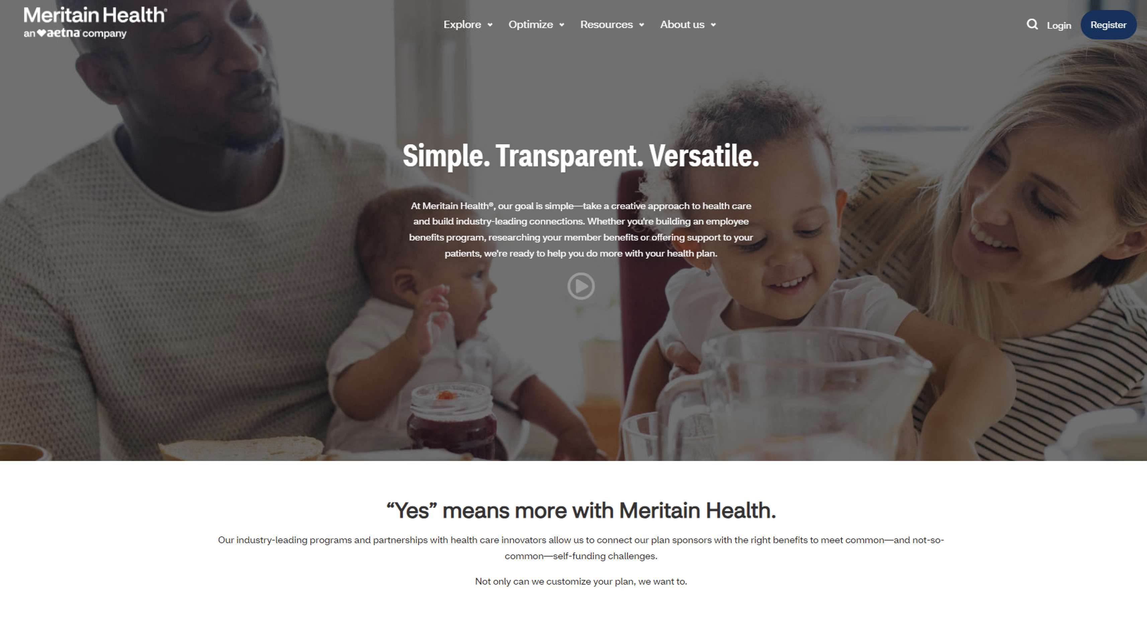
Meritain Health Member Website
Register or log in at www.meritain.com
Notes:
You can do all of the following and more on the portal:
View your account balance (HRA, HRA, FSA), claims status and history, EOBs and member statements
Find a provider or hospital in your network
Compare similar providers and hospitals
Research prescription drugs and learn more about generics
Sign up to receive mail order drugs
Take a health assessment
Estimate treatment costs
Calculate your BMI
Participate in online Active Lifestyle Coaching
Research health topics

Slide 23
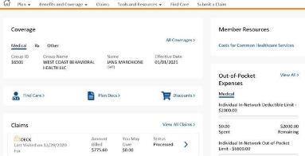
Features of the member website
We make your online health care experience more user-friendly than ever before.
With our new look and feel, the Meritain Health member website organizes your plan information in an easy-to-follow layout.
You’ll always know where to go next. Thanks to our new Quick Links, the pages you need are often one click away.
The website is an overall tool for:
Claims history.
Explanations of Benefits (EOBs).
Plan documents.
Eligibility details.
Wellness resources.
ID cards (view, print or request new cards).
You can access the website by computer, tablet or via the Meritain Health mobile app on your iPhone® or Android™.
Meritain Health Confidential

Slide 24
Section
6
Find balance between
good life and good health
24 | Meritain Health

Slide 25
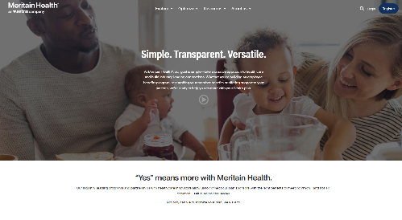
When you’re ready to enroll
Gather all information for you and any dependents you wish to enroll
Consider your personal health and that of your family members
Estimate annual health care expenses for you and your dependents
Make sure you choose the benefits that fit your needs
Double check every paper or online form
25 | Meritain Health
Meritain Health Confidential
Notes:
Action: Deleted red text that does not apply. Make text that does apply black.

Slide 26
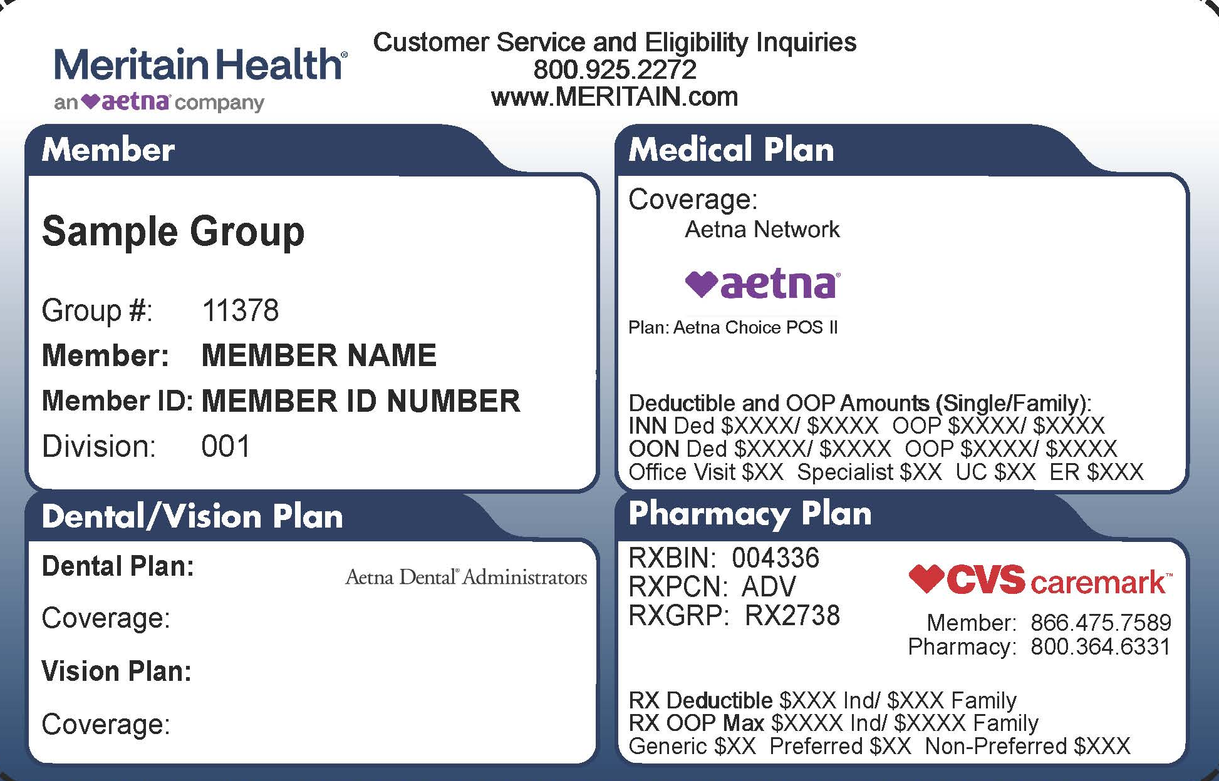
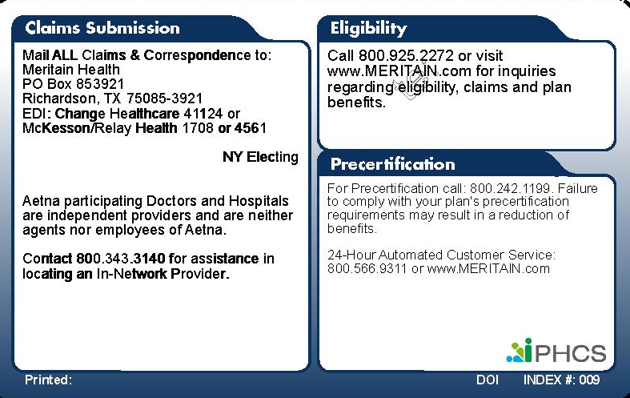
Easy-to-use ID cards
Front
Back

Slide 27
Get the help you need, when you need it
www.meritain.com
1.800.925.2272
Notes:
Talking points:
Verify eligibility, benefits, and claim status
Find in-network doctors and facilities
Get help understanding your plan
24/7 online access to your secure member account
Review and download plan documents, including ID cards
Other potential numbers to cover:
Scrip World 1.866.475.7589
Aetna Choice® POS II 1.800.343.3140
Medical Management 1.800.242.1199
Healthy Merits 1.877.348.4533
24x7 Nurse Line 1.866.726.6529
Teladoc 1.800.362.2667
Disease Management 1.888.610.0089

Slide 28
Who is Meritain Health?
Provides benefits to
+1,300,000
members nationwide
Meritain Health is an independent company of Aetna® and CVS Health®
We are one of the nation’s largest administrators of health benefits
We’re a Third Party Administrator (TPA) that offers employers customized benefit options to lower employee costs for health care
Meritain Health and Aetna are part of the CVS Health family of companies

Slide 29
Why Meritain Health?
Offer access to providers and facilities in the Aetna Choice® Point of Service (POS) II network and Aetna Open Choice® PPO Network.
Ongoing support with Meritain Health Member Advocacy team to ensure issue prevention and resolution.
Online member website provides easy access to find providers, check claims and download copy of ID card.

Slide 30
Questions?
30 | Meritain Health
Meritain Health Confidential

Slide 31
PROPRIETARY NOTICE
IMPORTANT CONFIDENTIALITY NOTICE - PLEASE READ! This Confidential Information, provided by Meritain Health, is intended only for the use of the addressee and only for the purpose that it is being provided. The Confidential information shall not be distributed, disclosed or conveyed to any consultant, subcontractor, vendor or other third party. The addressee is required to use appropriate safeguards to protect the Confidential information from unauthorized disclosure. If you are not the intended recipient, you are hereby notified that any disclosure, copying, distribution, or action taken in reliance on the contents of these documents is strictly prohibited. If you have received these documents in error, please notify the Meritain Health Privacy Officer immediately to arrange for their return at 1.800.831.1166.
31 | Meritain Health
31 | Meritain Health
Meritain Health Confidential

